Slide 1
Employee Data Analysis using Excel
STUDENT NAME: S.Kamali
REGISTER NO: 312261510 autunm1647cd1221647010
DEPARTMENT: B.com Bank Management
COLLEGE: R.B Gothi jain college for women
Notes:
autunm1647cd1221647010

Slide 2
PROJECT TITLE
Employee Performance Analysis using Excel

Slide 3


AGENDA
Problem Statement
Project Overview
End Users
Our Solution and Proposition
Dataset Description
Modelling Approach
Results and Discussion
Conclusion
3/21/2024 Annual Review

Slide 4

PROBLEM STATEMENT
Employee Performance analysis using Excel involves
Evaluating and measuring an employee ‘s work effectiveness
Of efficiency based on key performance indicators (KPIs)
This data is then analysed using Excel ‘s functions and tools,
Such as pivot tables, charts, and conditional formatting,
To identify patterns, strengths, and areas for improvement.

Slide 5

PROJECT OVERVIEW
The project “Employee performance Analysis using Excel ‘s ”
aims systematically evaluate employee productivity and
Effectiveness by leveraging Excel’s analytics tools. The project will involve collecting and organizing performance data such as task completion rates , accuracy and attached records. This data will be processed and analysed using Excel functions like pivot tables, charts, and statistical formulas to generate insights into individual and team performance.

Slide 6

OUR SOLUTION AND ITS VALUE PROPOSITION
Data_ Driven Insights: Enables managers to make informed decisions based on accurate, real _time
Performance data.
*Improved Efficiency: Automates the data collection and analysis process, saving time and
Reducing manual errors.
* Enhanced Employee Development: Identifies training needs and development opportunities, leading to a more skilled workforce.
Notes:
*Data_ Driven Insights: Enables managers to make informed decisions based on accurate, real _time
Performance data.
*Improved Efficiency: Automates the data collection and analysis process, saving time and
Reducing manual errors.
* Enhanced Employee Development: Identifies training needs and development opportunities, leading to a more skilled workforce.

Slide 7

THE "WOW" IN OUR SOLUTION
*Predictive Analytics: Integrating predictive models to forecast future performance trends based on historical data, giving managers a proactive approach to workforce planning.
*Automated Alerts: The tool can be set up to send automated Alerts for critical performance issues, ensuring that managers are immediately notified when attention is needed.
3/21/2024 Annual Review
7

Slide 8
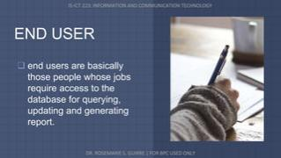

WHO ARE THE END USERS?

Slide 9
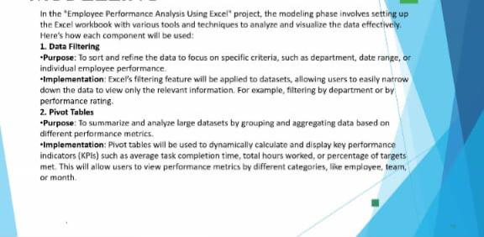
MODELLING
9
Notes:
In the “Employee performance Analysis Using Excel” project the Modeling phase involves setting up the Excel workbook with

Slide 10
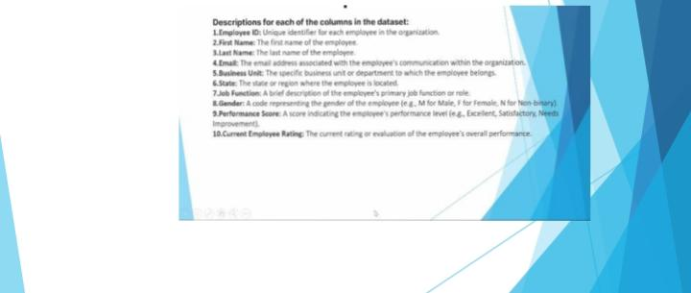
Dataset Description

Slide 11
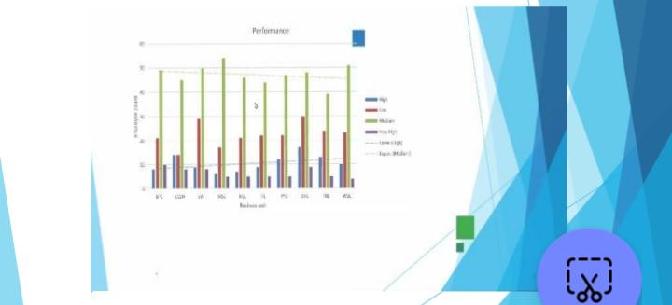
RESULTS
11

Slide 12
conclusion
The “ Employee performance Analysis Using Excel” project provides a robust and user friendly solution for evaluating and managing employee performance. By leveraging Excel’s powerful tools _ such as filtering ,pivot tables, charts , and conditional formatting the project transforms raw performance data into actionable insights. The resulting interactive dashboard and customizable Reports empower managers to make data driven decisions optimize workforce productivity , and foster Continuous improvement across the organisation. This solution not only streamlines performance management but also offers a cost-effective , scalable approach to enhancing overall organizational efficiency.
Notes:
The “ Employee performance Analysis Using Excel” project provides a robust and user friendly solution for evaluating and managing employee performance. By leveraging Excel’s powerful tools _ such as filtering ,pivot tables, charts , and conditional formatting the project transforms raw performance data into actionable insights. The resulting interactive dashboard and customizable Reports empower managers to make data driven decisions optimize workforce productivity , and foster Continuous improvement across the organisation. This solution not only streamlines performance management but also offers a cost-effective , scalable approach to enhancing overall organizational efficiency.

